Slide 1
Change the Way We Change
May 5th 2017

Slide 2
Change is upon all of us, and happening faster than ever. As businesses, we must rapidly respond, but how?
Do you agree that …? | As a consequence …
The Status Quo is Not Safe | Every company is now a technology company and must adapt and evolve to survive.
Client Journey Design/Execution is the Battle Ground | Clients are more demanding and better informed than ever before. They expect a full Omni channel experience and will leave if they do not get it.
Digital Disruption is Driving Significant Change | 40% of businesses will be disrupted by the arrival of new competitors with non traditional operating models.
Operating Models are Being Redesigned and Transformed | Artifical intelligence, analytics, robots, cognitive computing, automated decision making and digital technology are fundamentally changing the way work is done.
Collaboration and Working Across Teams is a Prerequisite | Organizations must rapidly adapt, evolve, collaborate, and build across disciplines and professions to survive.
Analytics Is Driving Change and Operational Effectiveness | Analytics about inline client experience and operational effectiveness with timely insight is now being used by many organizations to improve their client and employee experience
“Change the way we change”
Ensure our Operating Model Is Aligned With Business Strategy
Use Measurement and Analytics To Change The Dialogue
Put The Right People in the Right Roles

Slide 3
The classic Venn diagram is permeable and disappearing. This makes today’s change choices more difficult
As the mix converges and morphs, we must make wise choices

Slide 4
Use technology and good process design to simplify and automate how work is performed and how customers are served
In the world of digital labour, thoughtful choices will need to be made
Enterprise Operational
Intelligence
Automation Roadmap
Investments
Tech Enabled QA
Analytics and
Insight
Continuous Improvements
Pattern
Recognition
Approvals
Rule, Thresholds, Triggers
Learning
Improve-
ments
Standards &
QA
Expert Human Oversight
Leadership
Exceptions
Digital Measurement of Conduct Risk
Machine Learning and AI
Lean Hierarchy,
Lean Management
Thinking
Role of Virtual Labour
Creatively Use Technology, Simplify The ETE Process,
Reduce Risk, Improve Quality and GRC
Notes:
4

Slide 5
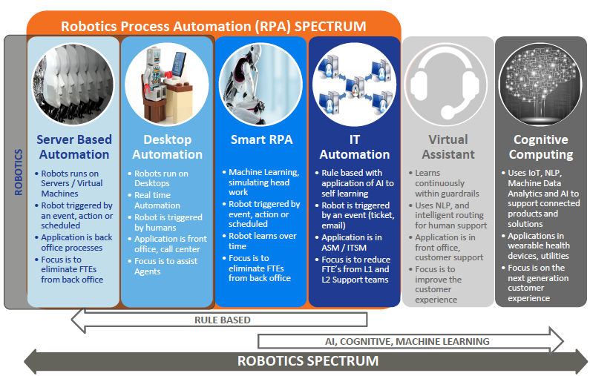
Reimagine the range of opportunities in customer and operational processes considering what is now possible
Source: Virtusa Polaris

Slide 6
Look at the problem from several perspectives to determine what to change, the sequence, and which levers to use
Thoughtful redesign of the operating model and end to end business processes
Service
Design
Human-centered design
About end-to-end customer experience
Underlying business processes and system about end-to-end
Three Levers:
Align your Operating Model to support strategy execution
Use analytics and measurement to change the dialogue
Put the right people in the right roles
1
Front to
Back
All of the internal and external interactions using analytics and technology to orchestrate
Processes to drive the right customer experience
2
3
End to End
Digital is not just about marketing
its an end to end and top to bottom
convergence of capabilities and technology
Align Strategy With Execution
Strategy determines the operating model drives the process, systems, applications and data architecture, business rules, policies and talent.
Leaders drive culture and behavior enabling a competitive client experience

Slide 7
Align your operating model to support strategy execution
1
Clearly tie operating model decisions into strategy execution
1
Strategic clarity and alignment
2
Processes Tied to Client Experience
3
Applications Designed In Context
4
Data Model Designed For Analytics
5
Requisite Talent & Leadership Specified
6
Fit For Purpose Tech Design and Build
7
Business Rule Clarity and Alignment
8
Workflow Planned By Client Journey
9
Standards Set for Reuse and Scale
10
Governance Risk & Compliance (GRC)

Slide 8
Use analytics and insight to measure the process “Inline” across the customer journey¹ to change the dialogue
2
Measure and analyze processes on an end-to-end basis from a customer perspective
Process Volumes and Activity
Timings/interval Volumes/errors Cycles/frequency Triggers & alerts Customer/client segments/groups using the process Manual workarounds No. of handoffs
Process Complexity
Happy/unhappy paths Structured and unstructured data Standards, SOP’s Third parties and supply chain Business rules Policy clarity Risk and compliance issues
Staff Skills and Cognitive Elements
Decision points Skills, experience, capability Homogeneous inputs Verification/interpretation required Cultural and behavioural factors Staff levels and mix
Systems and Applications
Application Inventory On premise, remote, third parties Infrastructure, servers, architecture Workflow, data used, missing Content, imaging, scanning, ocr
Financials/ROI
Costs per FTE Cost of errors/rework Application costs End to end costs Benefit of RFT Value estimate for 1% improvement Projected volumes/outlook
Customer/Client Metrics
Right first time % Top twenty irritants Quality metrics Experience/delays analysis by channel, cross channel Agent, CSR, salesforce, broker incentives, rewards
¹Henry Stewart Publications - Inaugural issue of the Journal of Digital Banking; The major new professional journal on using technology and automation to deliver a profitable, customer-focused digital banking strategy; See: Leave the Past Behind With Digital Process Management; Kunal Chopra, Financial Services Transformation and Business Effectiveness Leader and Neal Oswald, Co-founder of Wanilah Advisors Inc.

Slide 9
Put the right people in the right roles
3
Enable your people to successfully execute change by putting them in the right roles
LEAN HIERARCHY™ - Talent Gearing
Current Applied Capability (CAC): 3 overlapping elements
(ABLE)
Current Cognitive Power
(READY)
Knowledge, Skills, Experience
(WILLING)
Values, Culture, Temperament

Slide 10
How you approach the problem is as important as understanding the problem
Business Strategy
Business Model
Operating Model
Process Architecture and Client Journey Design
Data Model
Business Rules
Transformation and Change Execution
Thinking, Acting And Collaborating End to End (ETE)
Manage Complexity
Create an end to end line of sight for collaboration, review and approval
Create transparency and dialogue about the business change
Promote better IT and Business alignment and coordination
Manage Change
Facilitate the change, enable experts to guide, influence and decide
Establish an unrelenting focus on the customer and the employee experience
Design for scale, interoperability, efficiency and effectiveness
Deliver @ Speed
Reduce the cost of rework through clarity about the change
Tie components, rules, workflow, processes and data together to make sure they work as intended
Create standards, improve communication, shorten and eliminate cycles
Improve GRC
Design GRC into the fabric of the operating and business model
Clarify organizational roles and accountability
Establish metrics, controls, KPI’s and KRI’s so that management can manage
Notes:
Australia

Slide 11
In Summary: Changing the way you change will help retain more clients, grow revenue and protect your business
Align your operating model with business strategy
1
Use analytics and measurement to change your dialogue
2
Put the right people in the right roles
3
Retain Clients, Grow Revenue and Protect the Core

